Slide 1


Fundamentals of Risk Management
RM System, Process, & Program
Incident Investigation & Analysis
RM Tools & Challenges
People & Organizations
RM as Applied in Industry
Leadership in RM
Applications & Perspectives
On Becoming a
Leader in Risk Management
ENGG404 - Lecture
Chapter 7.1: The Fundamental Process of Management – The Plan-Do-Check-Act Cycle

Slide 2
Learning Outcomes:
Explain and apply the four steps of the fundamental process of management: Plan – Do – Check – Act (PDCA)
Explain how it relates to the risk management process and other risk management principles and practices.
Explain how it is essential for effectively managing the residual risk.
Chapter 7.1: The Fundamental Process of Management
2
Notes:
2

Slide 3
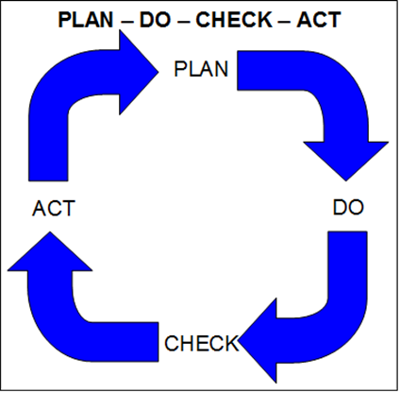
Introduction:
Plan - Do - Check - Act (PDCA) is a generic work process:
Process relates to any manager's work regardless of level, or title, or scope of interest or influence!
You, as an excellent leader in risk management, will practice this in all your jobs and throughout your career!
Chapter 7.1: The Fundamental Process of Management
3
Notes:
3

Slide 4
Introduction:
Plan - Do - Check - Act (PDCA)
Originated with Shewart and Deming.
  Aimed at quality and productivity in manufacturing.
  This process and its variants are globally
  practiced (e.g. Plan-Organize-Lead-Control,
  Plan-Execute-Review-Improve).
Tenets:
  Proactive – looking for issues before these have major impacts.
  Continuous Improvement – REPEAT! But the PDCA CI cycle does not stop after one (1) or a set # of cycles.
    For on-going operations, the frequency of repetitions decreases when the desired performance level is reached, but is repeated at a lower frequency to ensure the desired performance level is being maintained i.e. prevents “complacency and a gradual degradation in work practices and eventual return to low level of performance”.
    For project objectives, the cycle stops when the objective is met.
Chapter 7.1: The Fundamental Process of Management
4
Notes:
4

Slide 5
Applying PDCA:
Plan - Do - Check - Act in a little more detail:
Assemble the Team:
A problem has been identified that needs resources and a strategy to address
Sunset the Team:
The team has met its objectives and can “sunset” i.e. disband the team, free up resources for other teams
Some teams may go on indefinitely for their purposes i.e. continuous improvement. Other teams may sunset after meeting their objectives.
PLAN:
Define Problem
Identify Causes / Issues
Establish Objectives
Develop Plan
ACT:
Standardize Success
Adjust for Improvement
DO:
Implement Plan
Document Impacts of Plan
CHECK:
Measure and Analyze
Determine Effectiveness
Acceptable Improvement?
Chapter 7.1: The Fundamental Process of Management
5
Notes:
5

Slide 6
PDCA – Example as Applied to PTWs
Test at the Individual / Team Level e.g. how a leader may apply PDCA leading up to and during an audit (a planned inspection) on a critical safety rule:
Issues: Informal observations and anecdotal information indicates that workers are not following requirements of the PTW Checklists and Policy
Plan: Set expectations – explicit requirements for PTW with Checklists & Policy
Do: Communicate and train workers on the PTW Checklist and Policy
Check: Assess completed PTW forms against requirements; observe work practices i.e. planned inspections, during the creation and use of PTWs in the facility
Act: Take action to reinforce expectations:
  commend acceptable practices for those who follow all requirements
  correct sub-standard practices i.e. those who are not following all requirements of the PTW Checklist and Policy
Repeat the PDCA Cycle.
Q: Would the application of PDCA on Piper-Alpha, per this example, have prevented the catastrophic loss incident?
Chapter 7.1: The Fundamental Process of Management
6
Notes:
6

Slide 7
Example: PDCA
A leader may apply PDCA for the manufacture of electronic boards as listed in this “Test at the Individual / Team Level”:
Issues: Solder bridge welds; damaged/missing components; wrong components; excessive / insufficient solder; heat damages components
Plan: List the current defects, determine which occur most often, target most commonly occurring for assessment and correction, determine % improvement required and time period
Do: Adjust production parameters (temperature, speed, etc.) for different product models, track results
Check: Analyze results
Act: Present results to management, standardize changes resulting in significant improvements
Chapter 7.1: The Fundamental Process of Management
7
Notes:
7

Slide 8
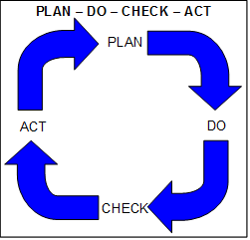
The Integration of PDCA into #1 MLCA and #6 PECI - APEGA:
Management is committed to implementing an effective and robust risk management program.
A large scale PDCA does this through program evaluation and continuous improvement.
ENGG404 Risk Management System and its 11 Elements:
Management Leadership, Commitment and Accountability.
Risk Assessment and Management of Risks.
Community Awareness and Emergency Preparedness.
Management of Change.
Incident Reporting, Investigation, Analysis and Actions.
Program Evaluation and Continuous Improvement.
Design, Construction and Start-up.
Operations and Maintenance.
Employee Competency and Training.
Contractor Competency and Integration.
Operations and Facilities Information and Documentation.
DRIVER
EVALUATION
Chapter 7.1: The Fundamental Process of Management
8
Notes:
8

Slide 9
The Integration of PDCA into #1 MLCA and #11 OIAI – OIMS:
The ExxonMobil OIMS (Operations & Integrity MS) and its 11 Elements:
DRIVER
EVALUATION
(aka PECI)
The similarities to the APEGA Model are readily apparent.
Chapter 7.1: The Fundamental Process of Management
9
Notes:
9

Slide 10
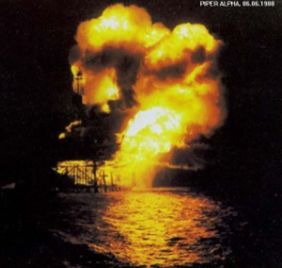
Summary and Key Lesson:
PLAN – DO – CHECK – ACT activities don’t “just happen”: management must make these activities happen.
Managers are actively engaged in driving these activities …
Piper-Alpha Key Lesson:
“Without sound leadership …
the control of risks breaks down and
unacceptable events will happen.”
Example: Management’s lack of checking
the PTW, lead to deficiencies in
controlling risks, and ultimately resulting
in the loss incident.
Chapter 7.1: The Fundamental Process of Management
10
Notes:
10

